Slide 1
COVID-19
A Broad Analysis of Cook County During Corona Crisis
Team 1
Cristal Garcia, Karlos Dodson, Laura Tociu, Surendiran Rangaraj

Slide 2


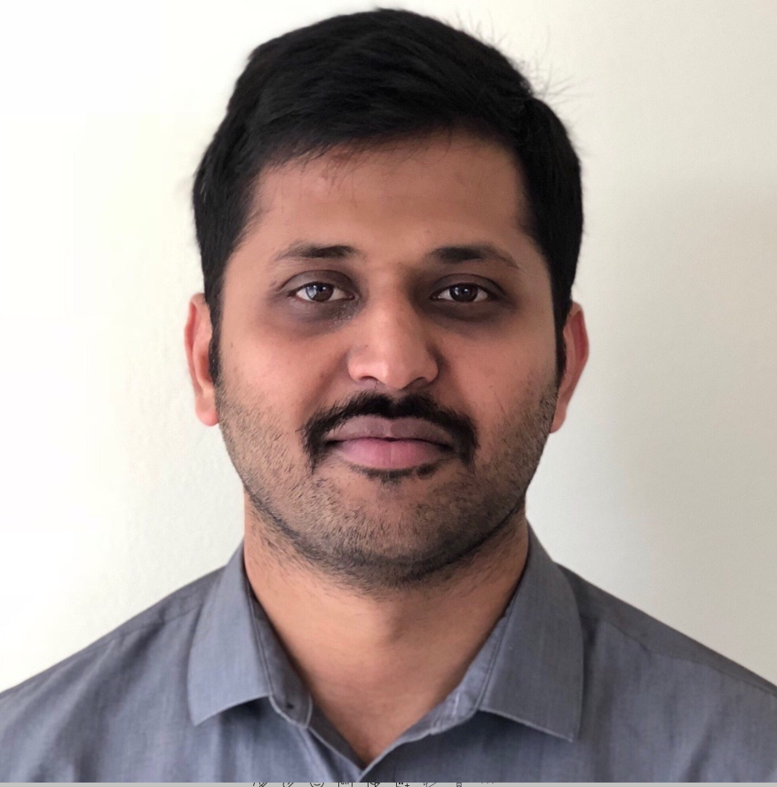

Team 1
Karlos Dodson
Part-Time Student
3rd Quarter
Cristal Garcia
Part-Time Student
3rd Quarter
Surendiran Rangaraj
Part-Time Student
1st Quarter
Laura Tociu
Part-Time Student
2nd Quarter

Slide 3
Executive Summary
The world is facing a global pandemic where real-time developments and the breadth of the data available have put to the test current practices.
To address this, we conducted a mixed methods approach where we utilized local data (survey), public data (news web scrape and behavioral data), and governmental data (IDPH, Cook County, CMS, and Census data) to see if we can uncover trends related to behavior, cases, deaths, and testing specific to COVID-19.
Through our investigations we found that due to different levels of granularity in date and location, it was difficult to use a Relational Database. Therefore we recommend when dealing with recent and ever-evolving data researchers design:
NoSQL databases
Uniform/standardized federal data collection guidelines
Notes:
a NoSQL database would serve a better purpose than RDBMS AND implementation of federal guidelines to avoid inconsistencies and variation of data—especially related to groups disproportionately affected historically.

Slide 4
Research Objective
We were curious to see:
What are the various types of data available during a state-of-emergency like the COVID-19 global pandemic?
What insights can we derive?
Understanding the complexity of working with data during such a tumultuous time is important to get a sense of the type of data available and:
Get a better understanding of the types of databases that would be best suited for short-term emergencies.

Slide 5

Data Profile

Slide 6
Data
 | Data Size | Rows/Col
Survey: population subsample of 455 across multiple states (289 from IL) | 144 KB | 455/30
IL Dep of Public Health (IDPH) COVID-19 case counts by age and ethnic group | 5 KB | 48/18
Cook County Medical-Examiner’s COVID-19 death counts in Illinois | 1.4 MB | 3977/25
Census Data: Income, Race and Age by Zipcode | 10 KB | 260/6
Centers for Medicare & Medicaid Services: Nursing home COVID-19 | 15 KB | 211/10
Web scraped news articles | 12.1 MB | 3469/3
Social Distancing data from SafeGraph | 64 GB | ~30 million/20
Global Mobility Reports from Google | 31.1 MB | ~500000/11
Notes:
University of Chicago Health data: https://www.chicago.gov/city/en/sites/covid-19/home/latest-data.html

Slide 7
Data Profile
Matching Methods/Algorithms:
Python – web scraping, natural language processing, big data cleaning (SafeGraph ~ 60 GB)
OpenRefine – survey cleaning
MySQL – database storage
Outliers and Anomalies:
Incomplete SafeGraph data – unable to complete analysis for some ZIP codes and hard to determine accuracy for others
Missing nursing home ratings – unable to include in analysis
Aggregations:
Count of COVID-19 tests, cases, and deaths in cook county by age, ethnic group, and income
Survey aggregation by ZIP code
Social distancing metrics from SafeGraph aggregated by ZIP code
Full Datasets for initial exploratory analysis include:
IDPH COVID-10 cases
Cook County Medical-Examiner’s COVID-19 death cases
Census Data (income, ethnicity and age)
Centers for Medicare & Medicaid Services COVID-19 nursing home data
News articles from main newspapers in 10 big cities in the US for web scraping
SafeGraph social distancing data from all around the US
DataWorld’s location (city, state, county, and zipcode)
Survey data created and collected by team.
Notes:
o Evaluation of analytical or transactional data stores for the use cases

Slide 8
Data Assessment
Identify
Current state of COVID-19 data: not consistent across data sources. Don’t have full granularity of date or location, and no quality checks available.
Analyze
The database now has granularity across Cook County zipcodes for standardization.
Model
Quality metrics comprise of: cases, tests, and deaths by ethnicity, age, and income.
Integrate
Upload data and date information ETL process to upload in database/warehouse.
Govern
Validate data daily to look for missed data loads. Implement data rationalization.
Notes:
-Identify: determine the current state of enterprise data, processes, technology & tools
-Analyze: correct errors, standardize information
-Model: determine the quality metrics and automate rules to enrich data
-Integrate: integrate tools, processes, applications and data across multiple sources
-Govern: data validation by monitoring data health checks

Slide 9
Data Quality Dimensions
01
Completeness
100% Completion of COVID-19 data by race for Cook County.
Survey data is incomplete and consists of sampling/selection bias.
SafeGraph social distancing data missing 20% of ZIP codes in Cook county.
02
Validity
05
Timeliness
In process of cleaning and constructing database, we made sure data format and types were consistent in tables.
The trends observed as a function of time appear consistent with what we'd expect. Furthermore, all data sets were derived from reputable sources with sound data collection techniques.
03
Uniqueness
06
Accuracy
Survey data was cleared of duplicates. Tables were all normalized in dimensional-model.
We did not observe any red flags or obvious inconsistencies with reality in the data. Despite the breadth of data diverse data source, we believe the story told by the data to be representative of the reality of Covid as we experienced it personally.
04
Consistency
Made sure to use COVID-19 data that included race/ethnicity for consistent evaluation in health-related data.
All data was aggregated to ZIP code even if initially it was available in different format.
Notes:
Completeness: are values missing?
Validity: does the data match the rules?
Uniqueness: is there duplicated data?
Consistency: is the data consistent across various data stores?
Timeliness: does the data represent reality from the required point in time?
Accuracy: the degree to which the data represents reality.

Slide 10
Methodology
Notes:
o Evaluation of analytical or transactional data stores for the use cases
o Automation methodology for the End to End pipeline.
o At-least 5 database tables, ER diagram, normalization, use of SQL queries
o NoSQL databases along with the JSON data model, if applicable

Slide 11

Data Platform
Data Collection
Data Curation/Data Science
Data Delivery
Insights
Survey
IDPH Cases Data
OLAP
Med Examiner Deaths Data
Census Income
MySQL
MySQL
CMS: Nursing Data
Social Distancing Data
Web Scrape: News
Data Lake
Reports
Google Mobility Data
Governance
Notes:
Thanks Laura. Here we have our Data Platform. You can see the tools we used in Data Collection to Data Curation and Data Science to Data Delivery and to our insights using OLAP.
I want to point out that we used Social distancing data from SAFEGRAPH – this particular dataset uses GPS pings from cellphones to track people's stay-at-home behavior and/or mobility.

Slide 12








Tools
Ingestion & Cleanup
Storage
Delivery & Insights
Data cleaned using Open Refine, Python, and MySQL
Web scraped data from news sources using Python.
Survey created using Google Forms.
Database created using MySQL.
CloudSQL to build and store DDL & DML tables
Reports generated from Tableau and Python to draw insights
Notes:
As you can here are the platforms we used for Ingestion and Cleanup, Storage and Delivery & Insights.
GCP was utilized to load the datasets, execute DDL,DML in CloudSQL. We connected with Mysql and Tableau for the team members to work in parallel to make modifications and to visualize.

Slide 13
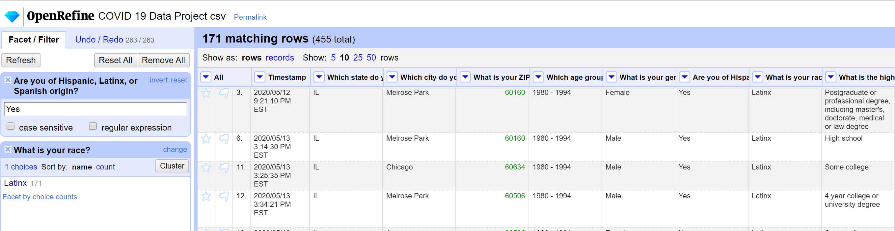
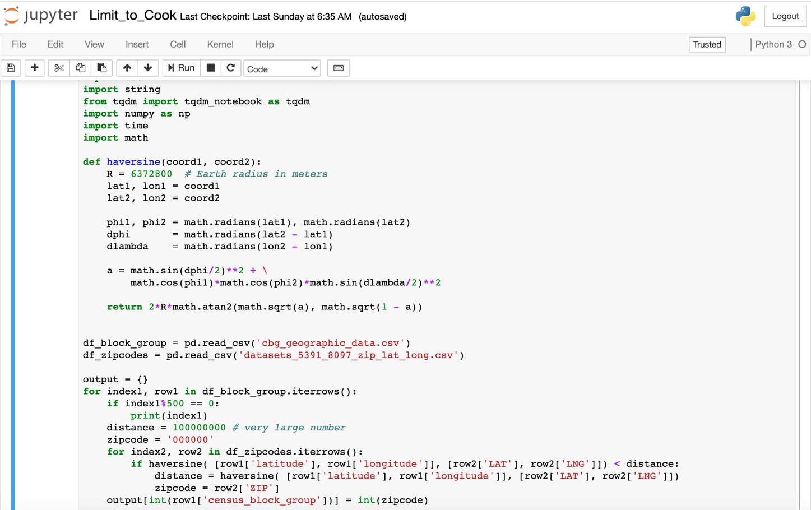
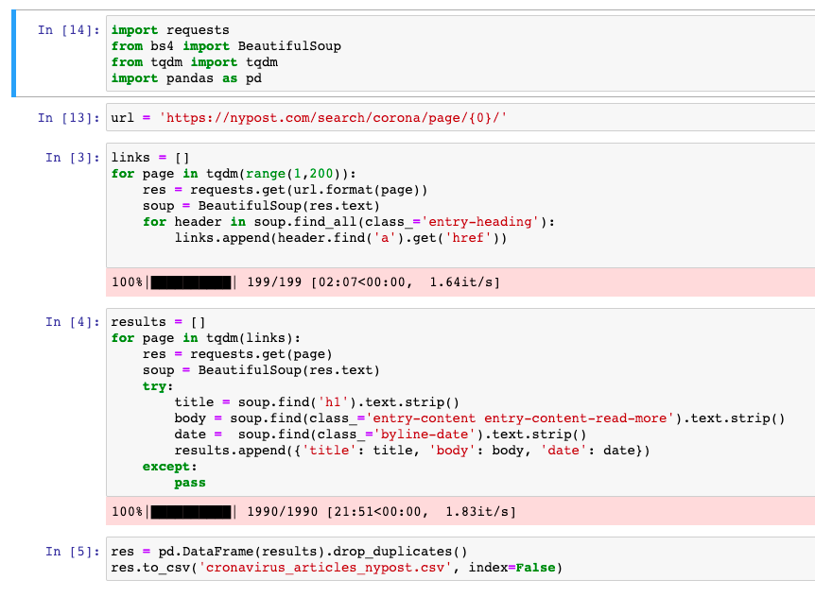
Data Cleanup
Race/ Ethnicity
Reclassified race to be more ethnocentrically inclusive
Web Scraping
Geographical Scope
Spacing, special characters and formatting
Survey response: IL 63.5% of respondents
Narrowed in on ZIP codes for Cook County: 228
Notes:
For Data cleanup we used Web Scraping for spacing and special characters. We used Open Refine/Python/and MySQL to clean up general information such as race, facility name and address inconsistencies, and other items.
Suren will now talk about Design Considerations for RDBMS

Slide 14
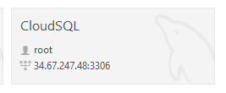
Design Considerations for RDBMS
Data Integrity
• Establish Unique Primary key for each entity/table
• Define NULL explicitly for columns that are undefined
• Establish foreign key relationship and constraints(Not Null, Unique)
• Define Default values for missing attributes wherever applicable
ex; Default update timestamps to current timestamps, Default adeq_care_ind with value 'N' if not available.
Data Types/Indexing
• Choose Integer datatypes for Primary keys and numbers
• Define Date attributes with datatypes Date or timestamp
• Follow standard naming convention for attributes
ex; suffix all primary keys with _id, Suffix index values with _idx
• Create Index for frequently queried columns like date
• Partition the tables with date attributes by date
Database Modeling
OLTP
• Normalized Physical Entity-Relationship Model
OLAP
• Multi-dimensional Snowflake Model
• Two facts tables representing different granularity.
Notes:
What elements of the data will be stored ?
•How large each element can be ?
•What kind of information each element can contain ?
•What elements may be left blank ?
•Which elements are constrained to a fixed range ?
•Whether and how various tables are to be linked ?

Slide 15
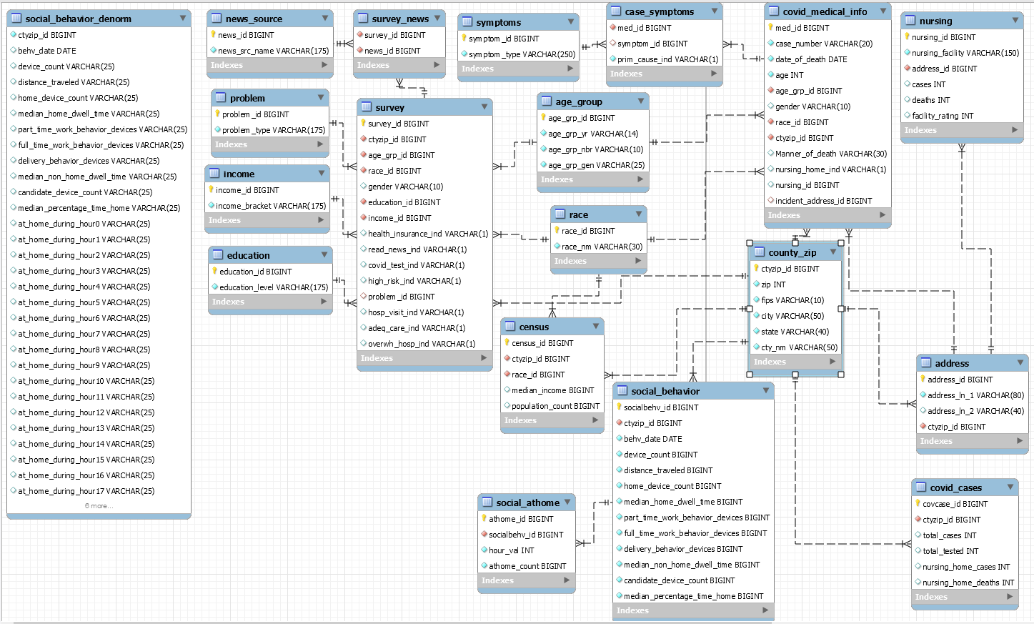
EER Model
Notes:
SQL workbench file or screenshot
All scripts file(SQL/Python/R ) containing all analysis/modeling queries o Visualization Dashboards/Reports – Tableau, Excel or PowerBI, etc. (raw files) o Final Presentation slides (as PPT)

Slide 16
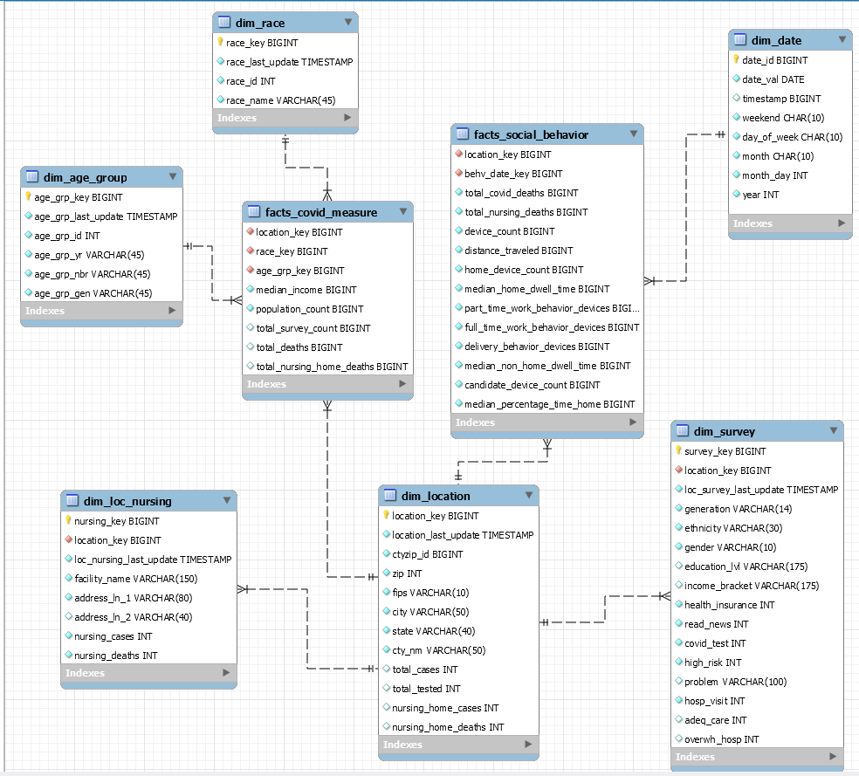
Dimensional Model

Slide 17

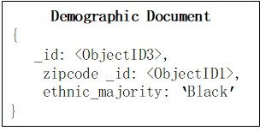
MongoDB
Document Database:
Disjoint data would benefit from the minimal constraints of simplified queries.
More flexible data store for new datapoints.
Collections (tables):
Cases
Survey
News sources
Behavior
Document (row)—Ex. Cases:
Zipcode
Covid cases
Demographic
Nursing homes
COVID Case Document
{
_id: <ObjectID2>,
zipcode _id: <ObjectID1>,
Total_cases: ‘12’,
Total_testdeaths: ‘8’
}
Zipcode Document
{
_id: <ObjectID1>,
name: ‘60428’
}
Nursing Document
{
_id: <ObjectID3>,
zipcode _id: <ObjectID1>,
name: ‘David Webb, Jr. Senior Living
Complex’
address: ‘16427 South Dixie High way’
}
Notes:
Explain if you can implement MongoDB or Neo4J? Why or Why not? If so, how? Extra points if you try implementing.
Webscraped news sources:
Create tags for sentiment analysis

Slide 18
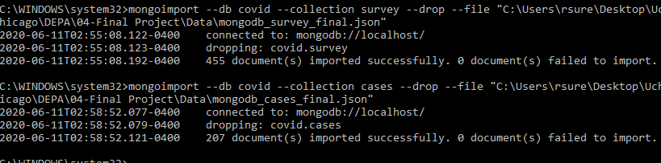
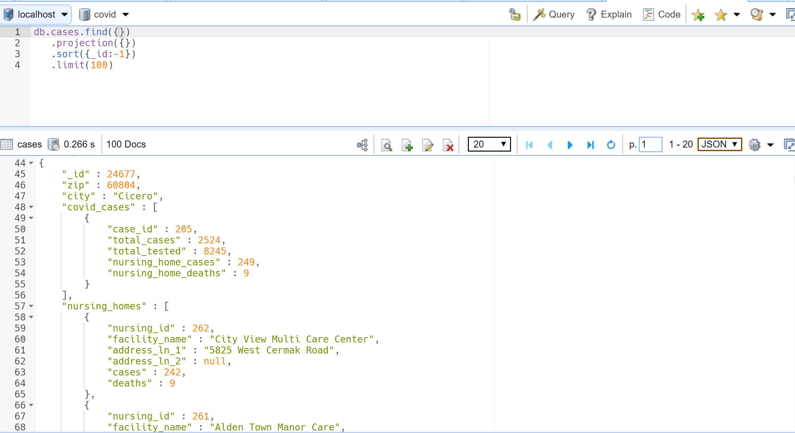
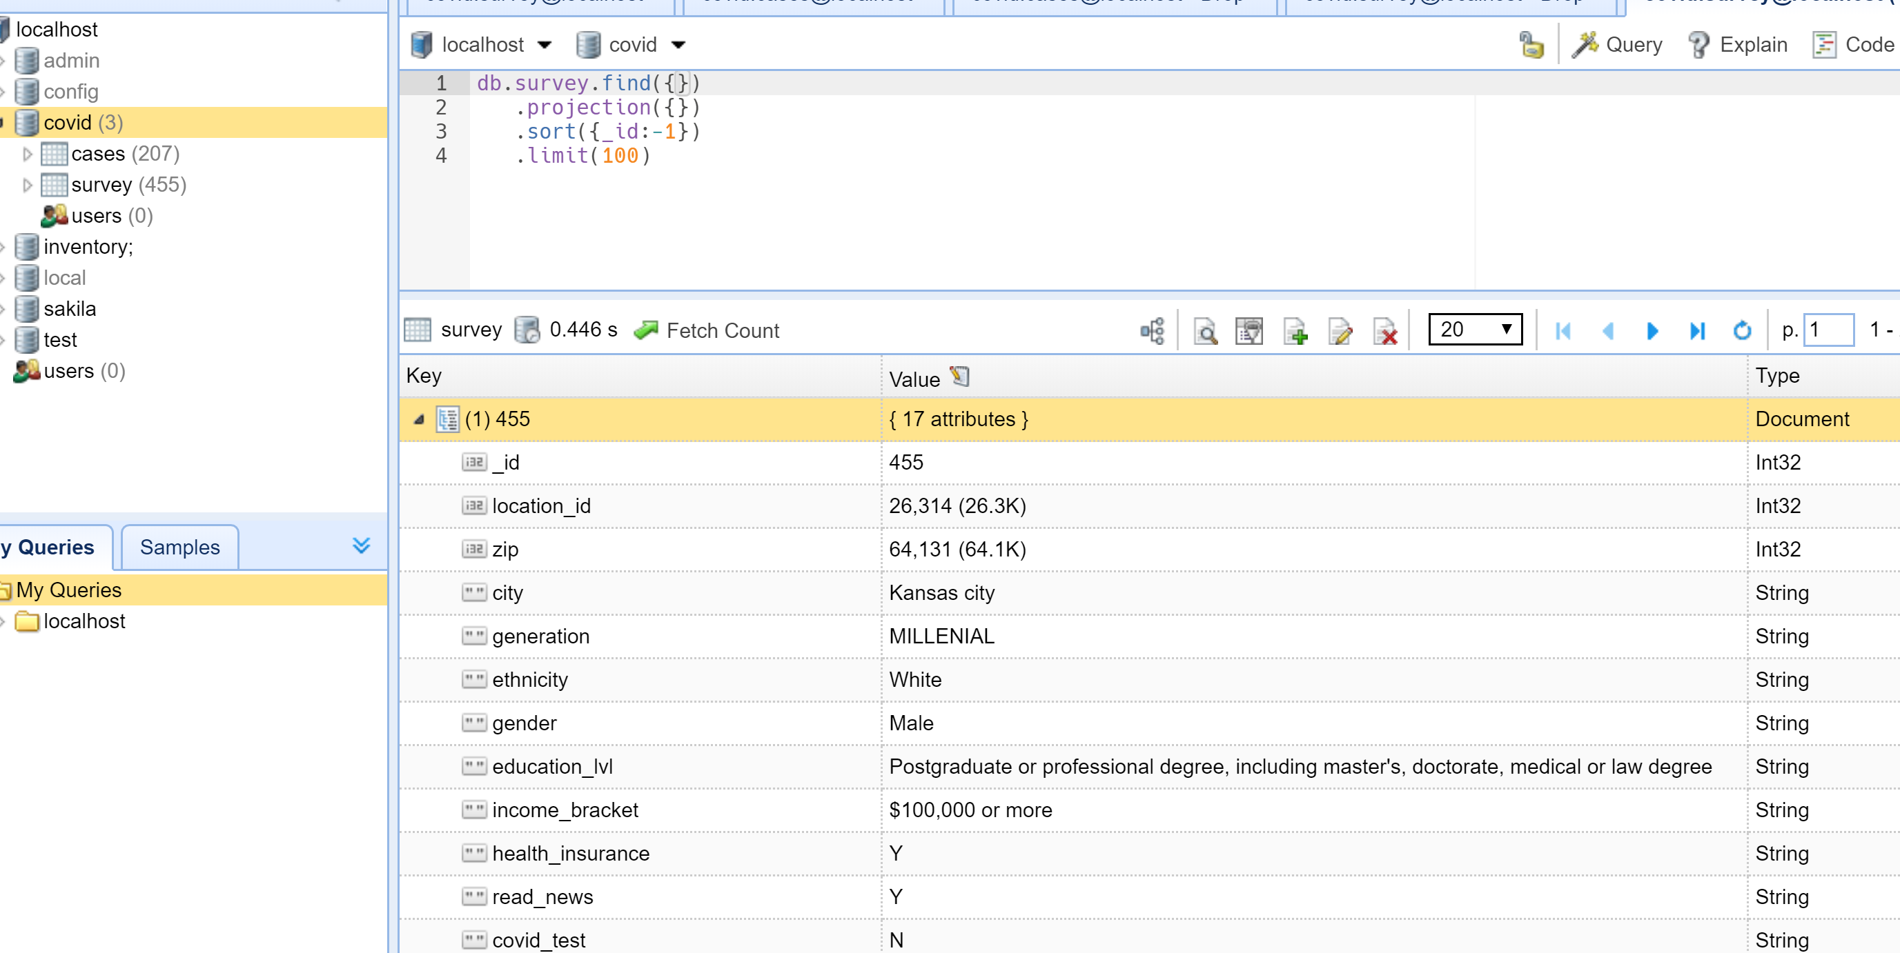
MongoDB - Collections
Cases Collection:
Survey Collection:

Slide 19

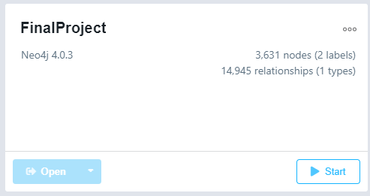
Neo4J
Graph Database:
Schema free nature help recognize new relationships.
Data access: beneficial as time-based data continues to grow (naturally additive)
Nodes: COVID-19 cases, location
Use labels related to: deaths and tests
Relationship: distance
Identify clusters or growing clusters over time.
Transactional information provided by SafeGraph’s social distancing phone data.
Count of Devices
Distance
Zipcode
Notes:
We do see an opportunity to use Neo4J with the with COVID-19 related data.
-Transactional data provided by SafeGraph’s social distancing data gathered from cell phones.

Slide 20
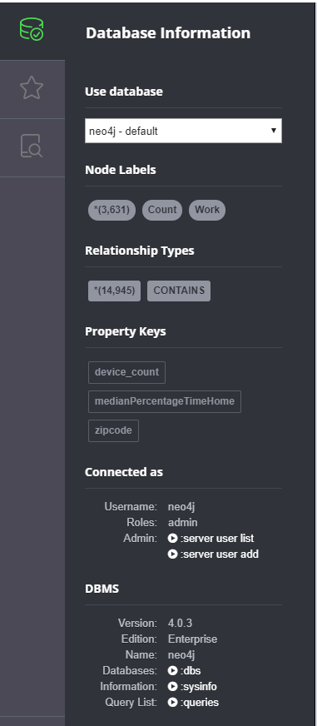
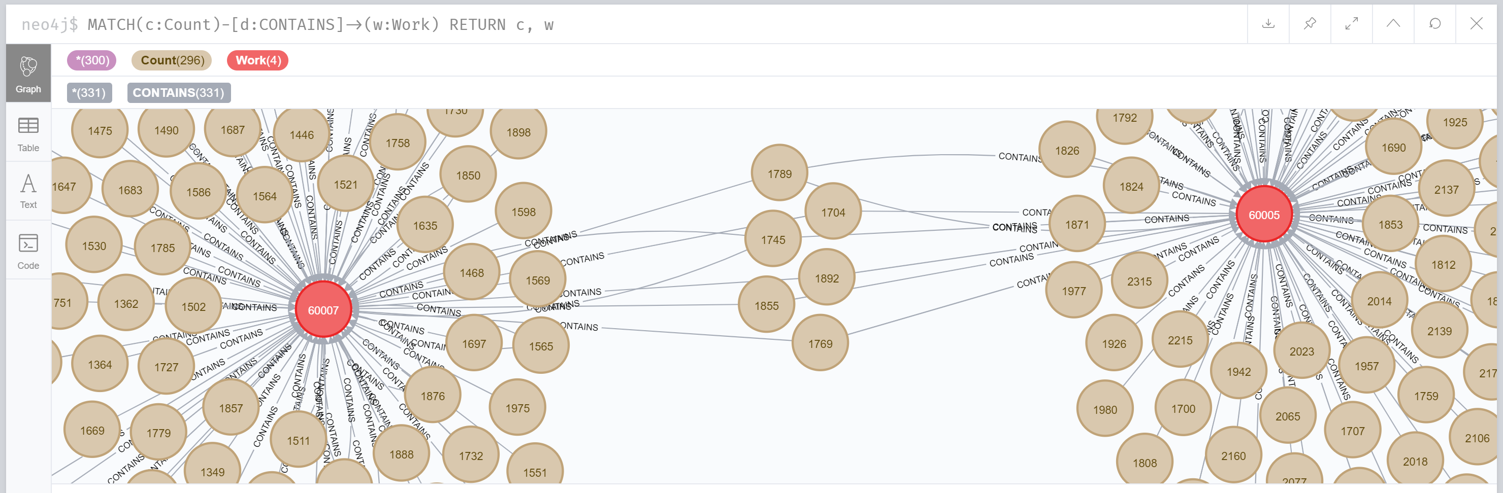
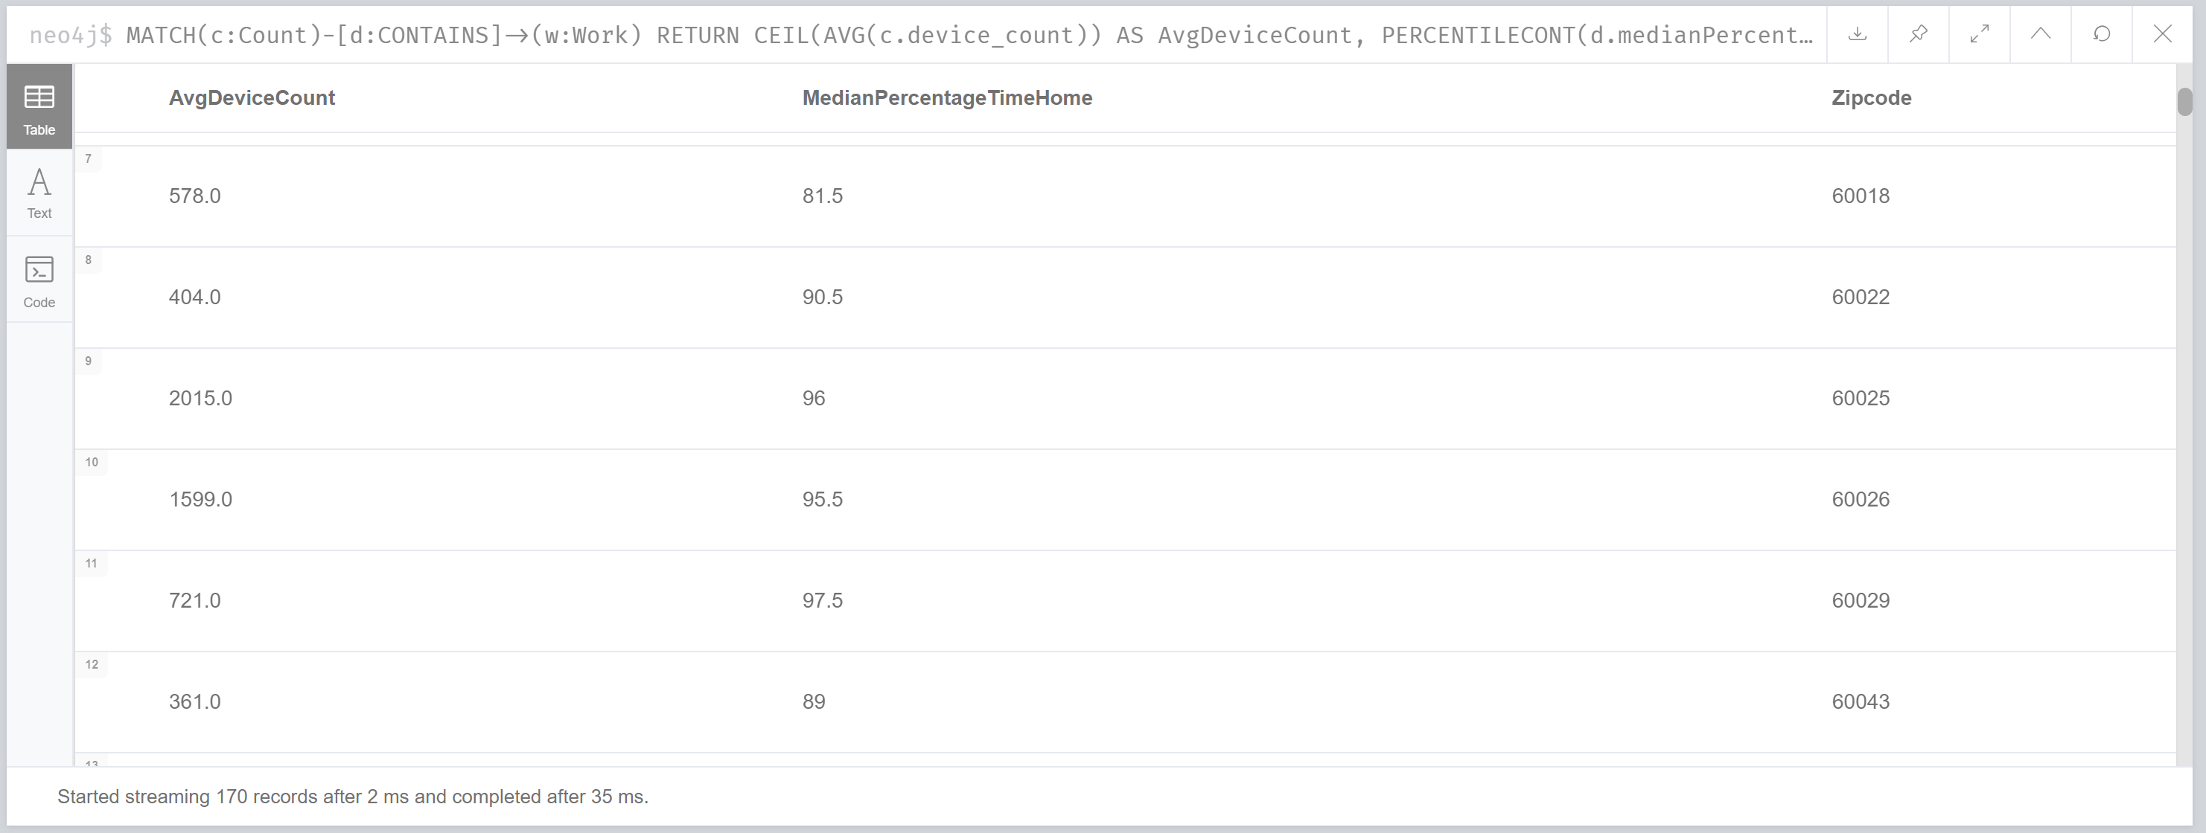

Slide 21
Insights

Slide 22
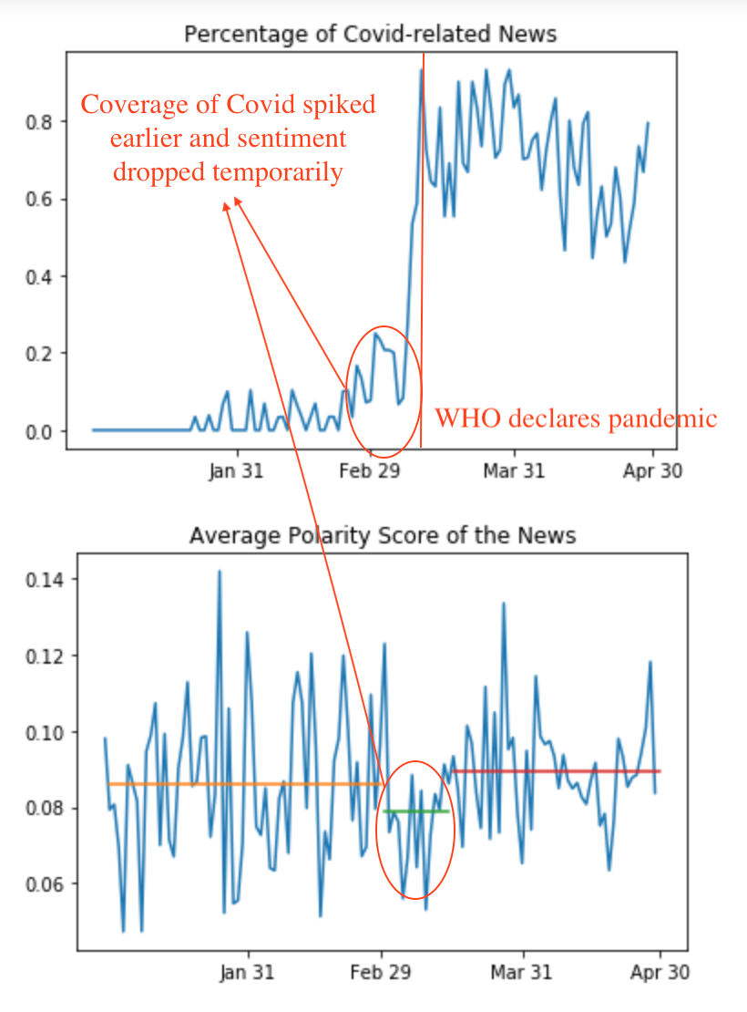
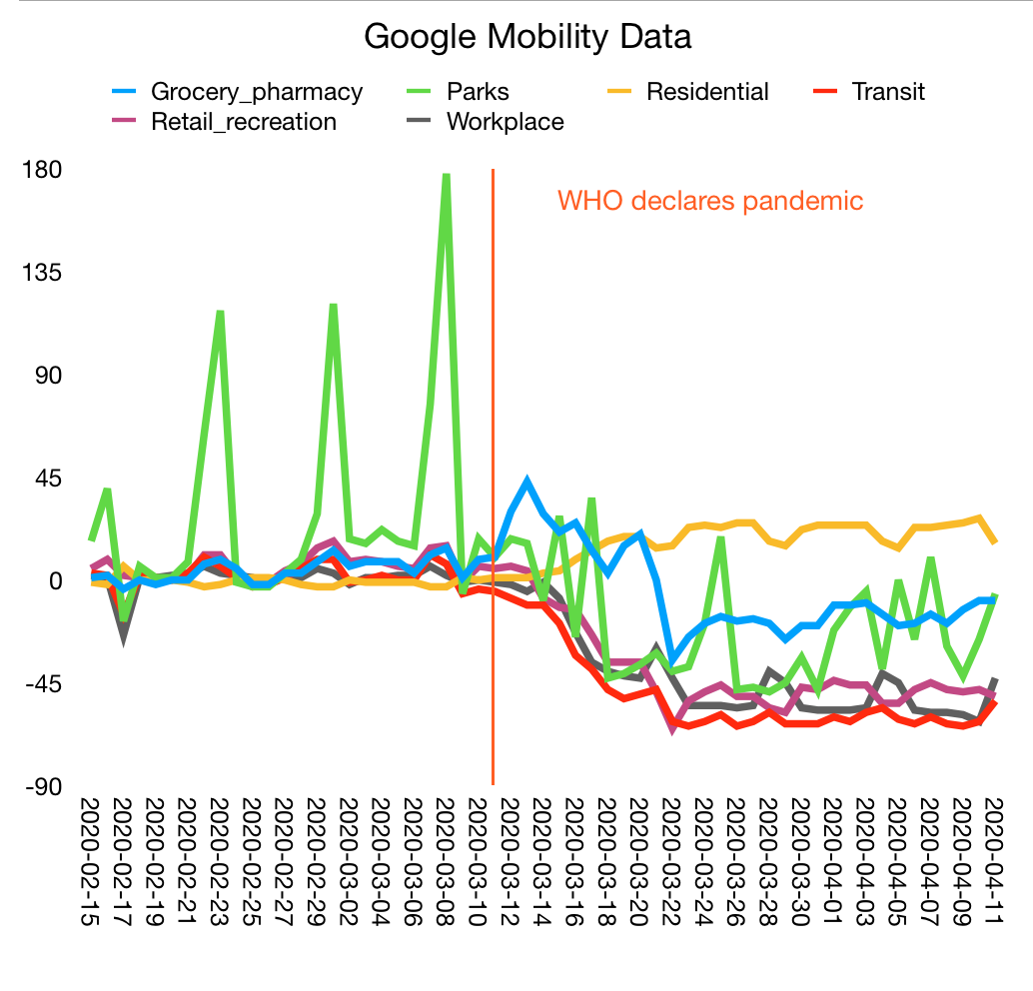
Timeline of Covid Awareness (Awakeness?)
What were the important
milestones in people waking up to Covid?

Slide 23
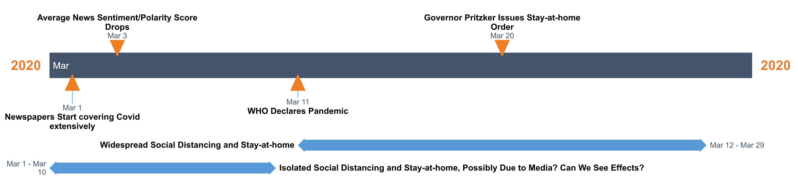
Timeline of Covid Awareness (Awakeness?)
The timeline suggests 4 periods of 10 days that may be interesting to study:
Last 10 days of February – baseline of "normal life"
First 10 days of March – media picked up on Covid; some people became cautious and moved less (?)
Middle 10 days of March – WHO has declared pandemic, mobility started going down
Last 10 days of March – State-mandated Stay-at-home order, mobility decreased substantially

Slide 24
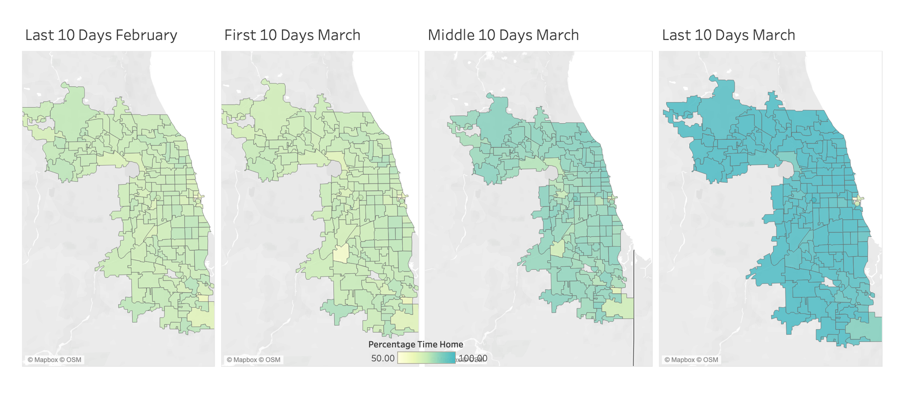
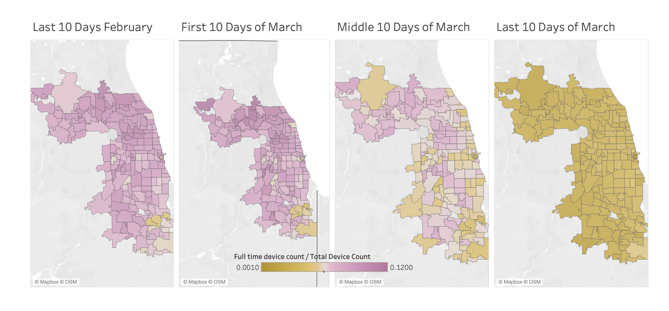
Staying home increased and going to work decreased
between March 10-20 in Cook county, UNIFORMLY

Slide 25
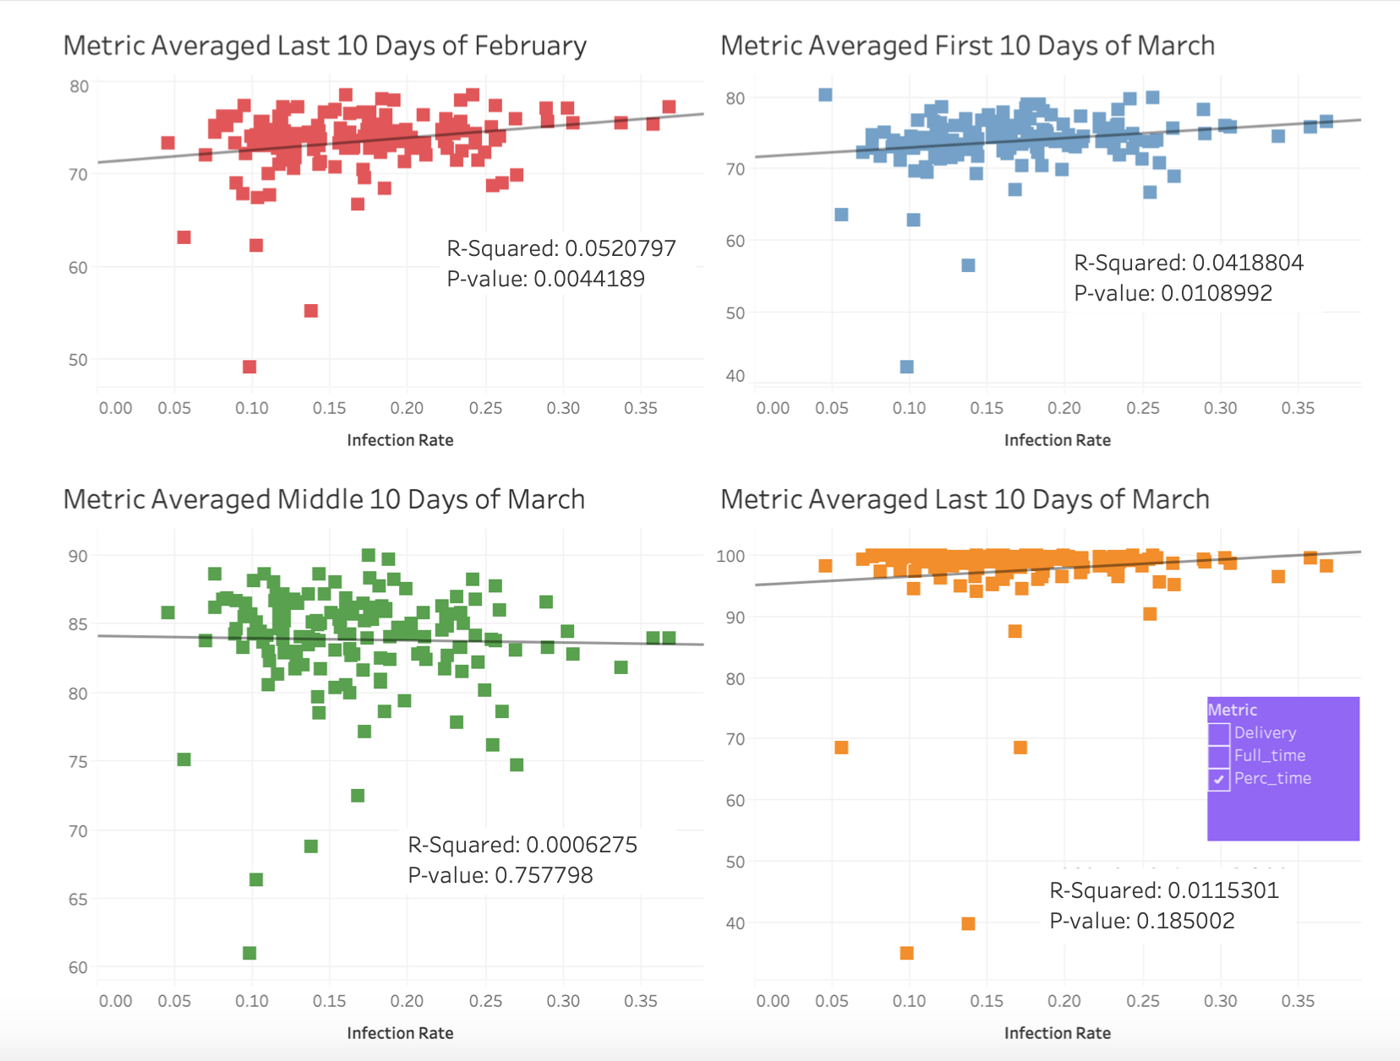
Stay-at-home Behavior Versus Infection Rates Appears
Noisy and Uncorrelated.
Period March 10 – March 20 Has Slight Negative Correlation

Slide 26
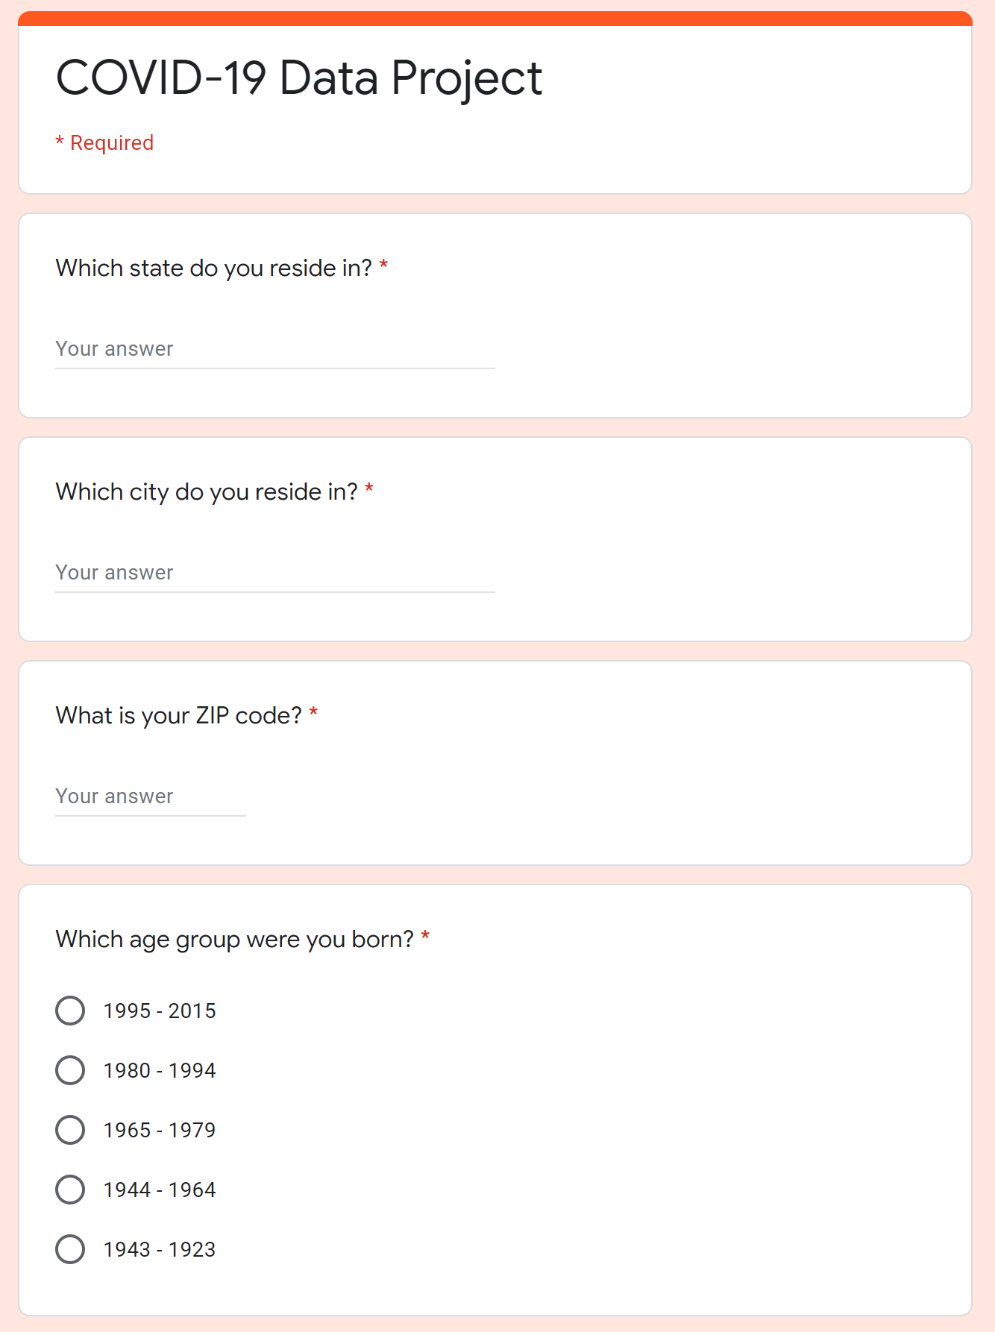
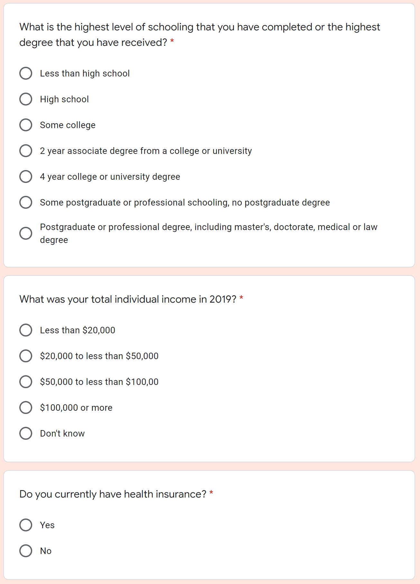
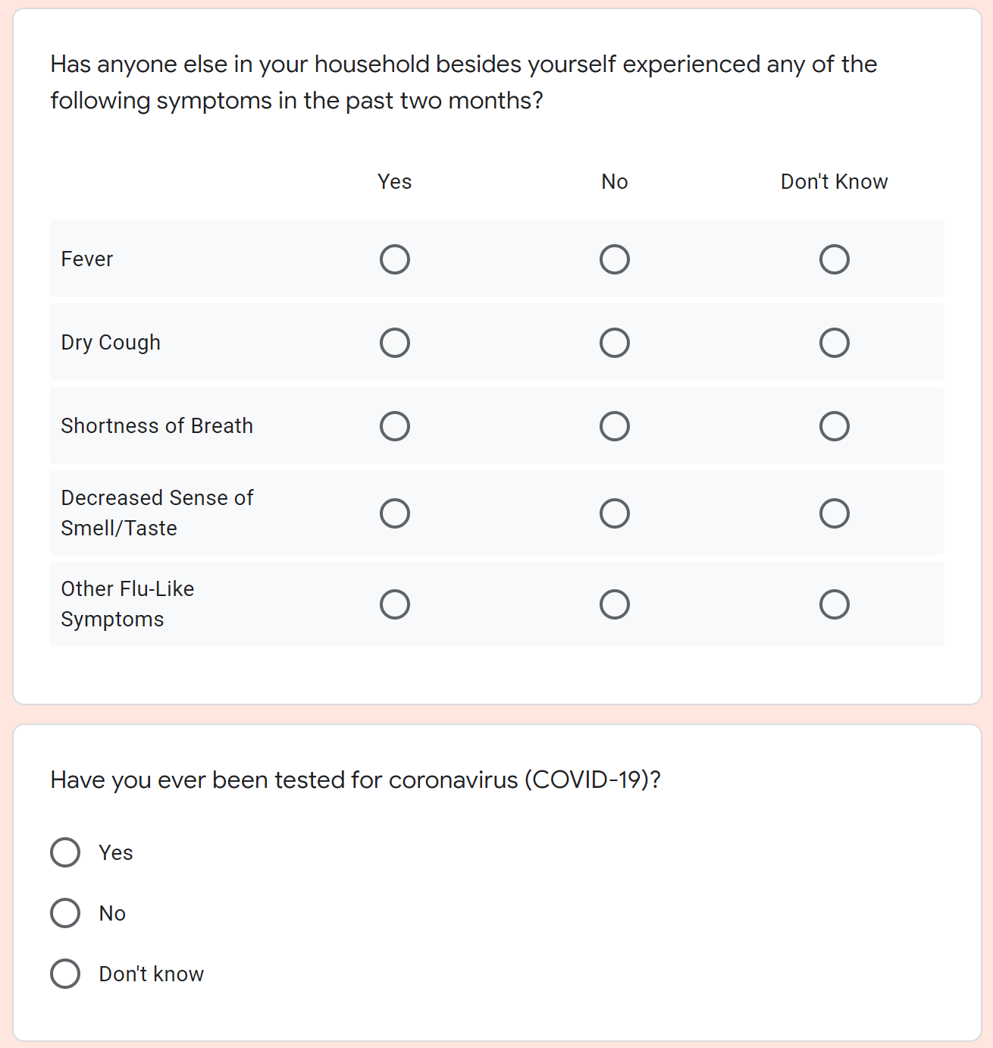
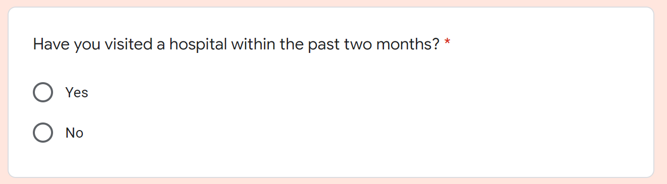
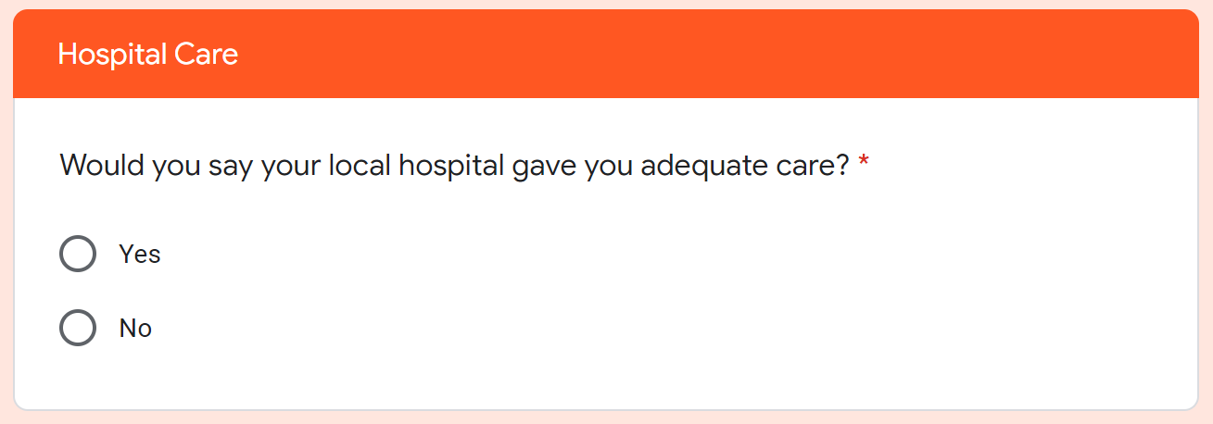
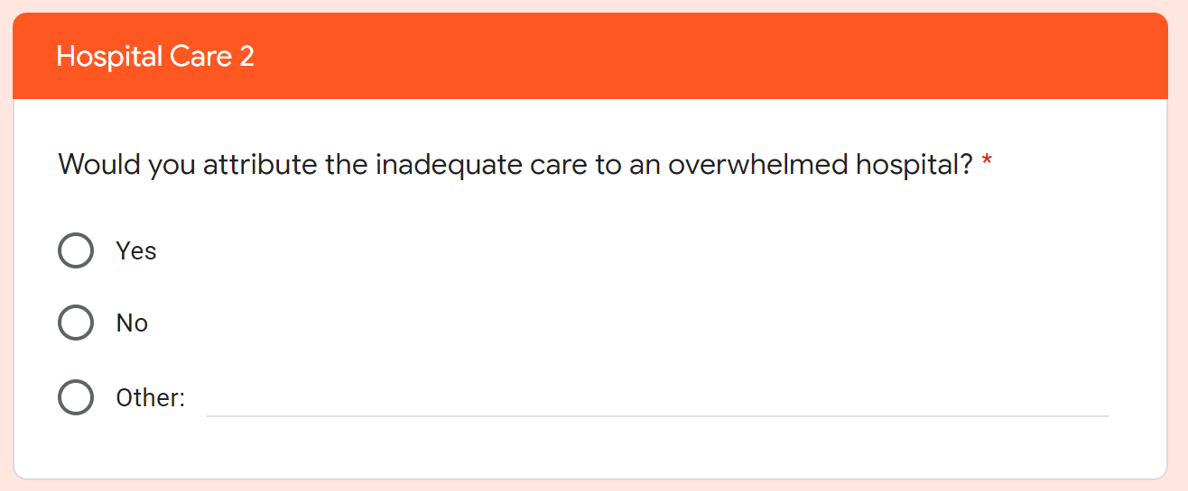
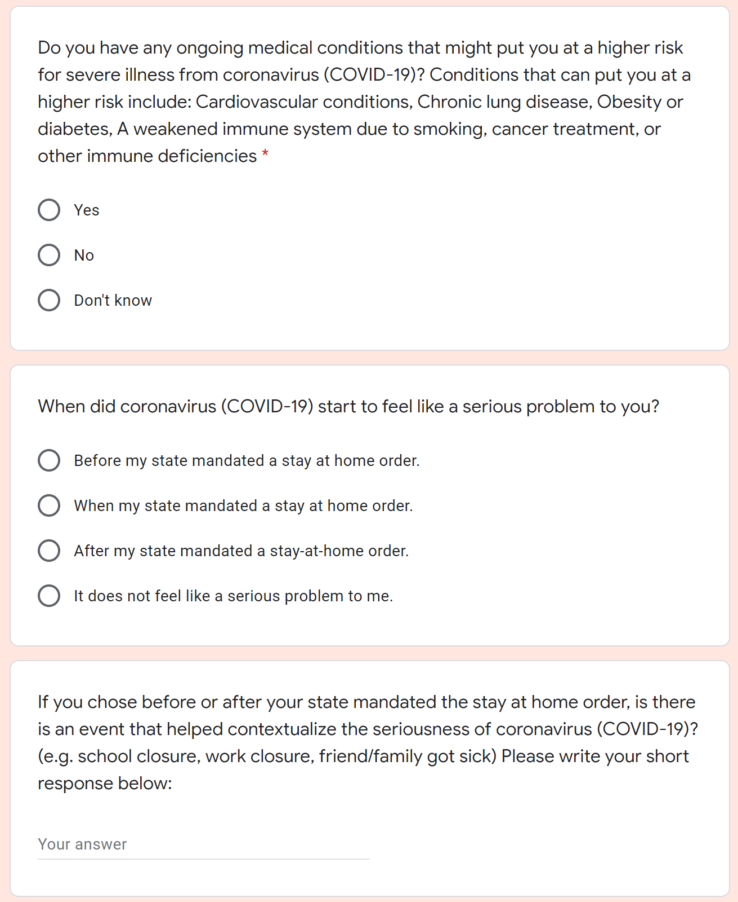
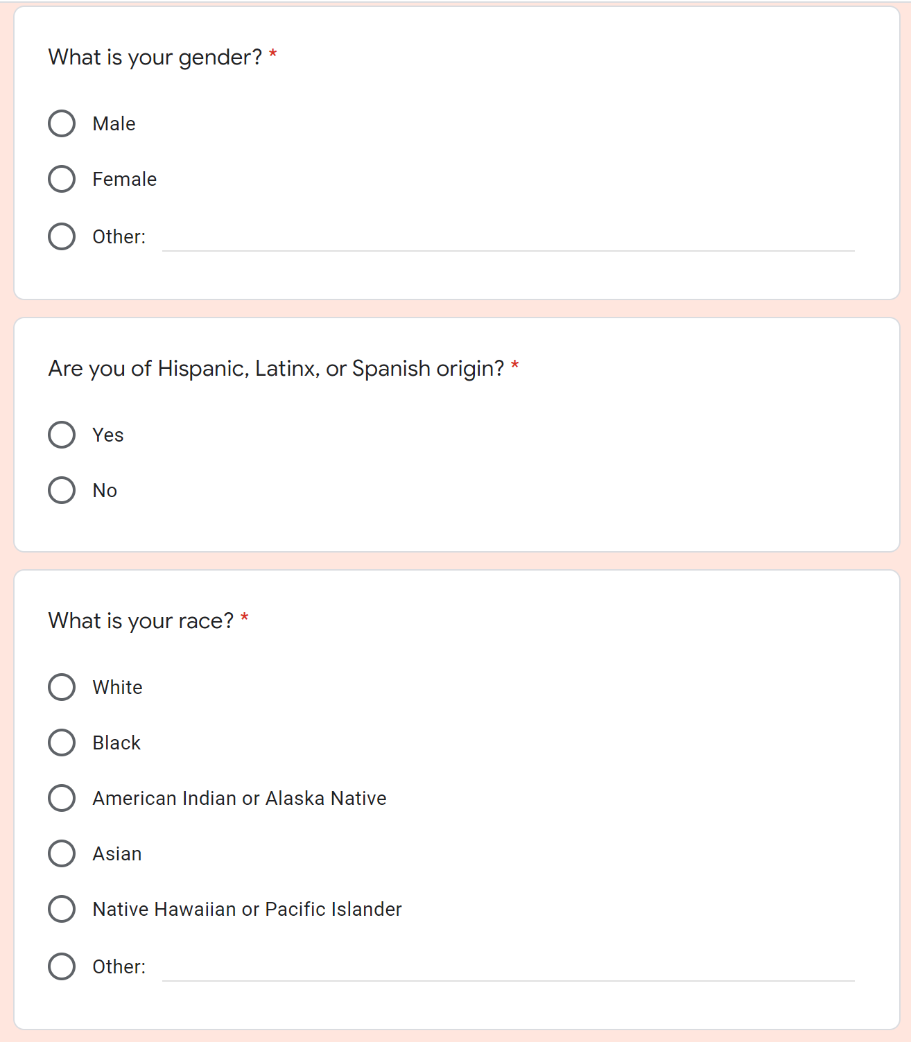
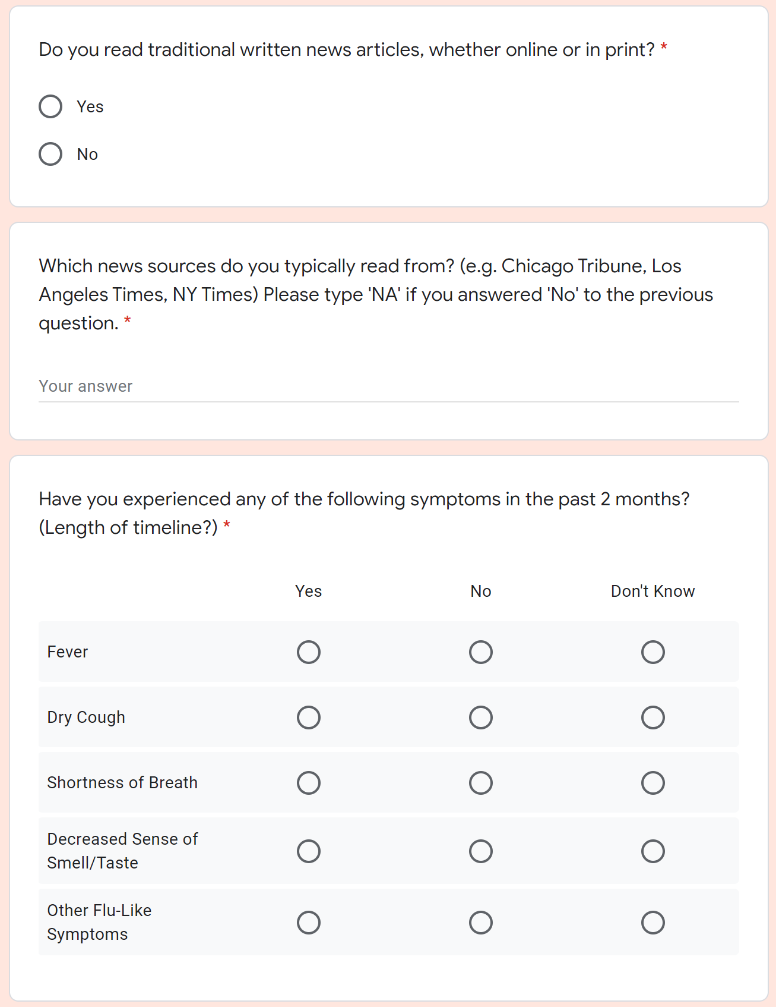
Survey Questions
Summary: 455 responses from 19 different states. 289 responses from IL (219 from Cook County).

Slide 27
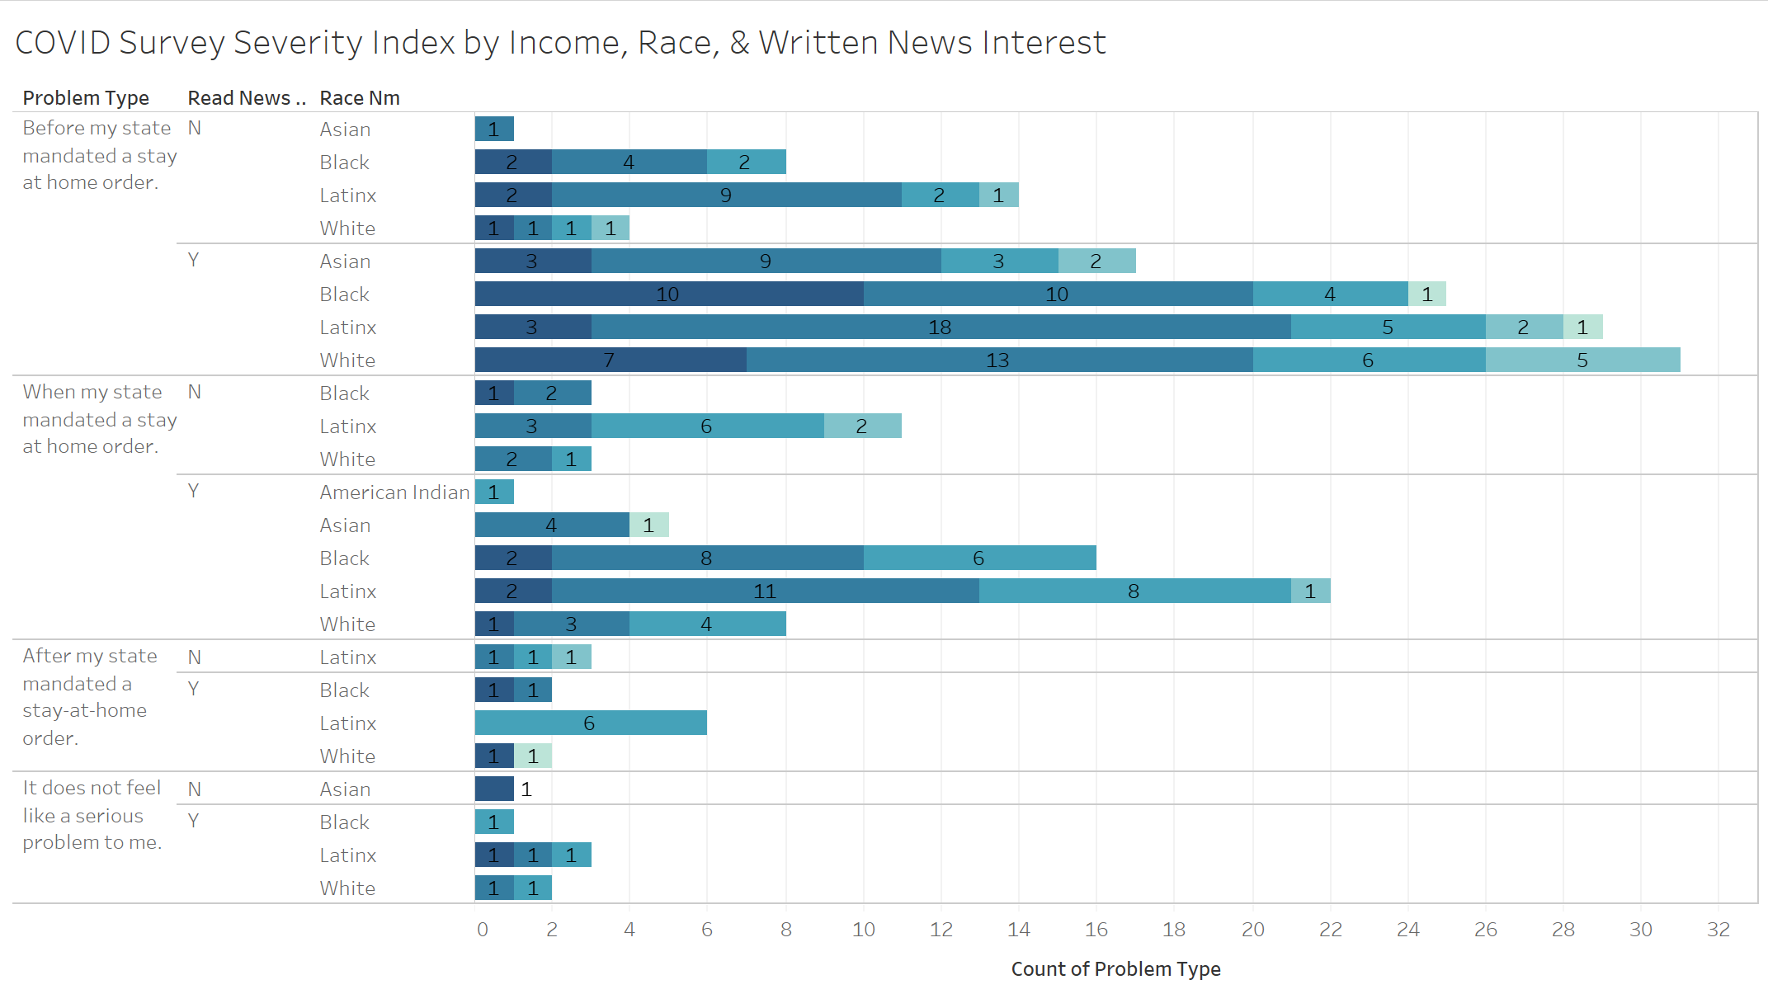
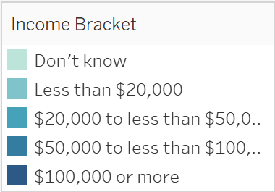
Survey Insights

Slide 28
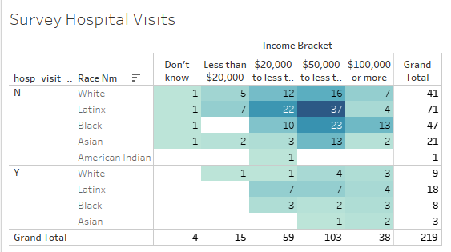
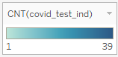
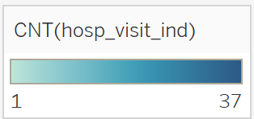
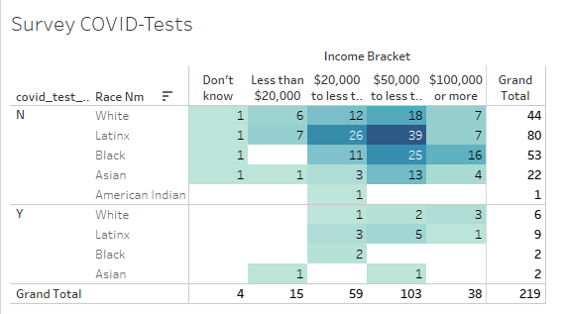
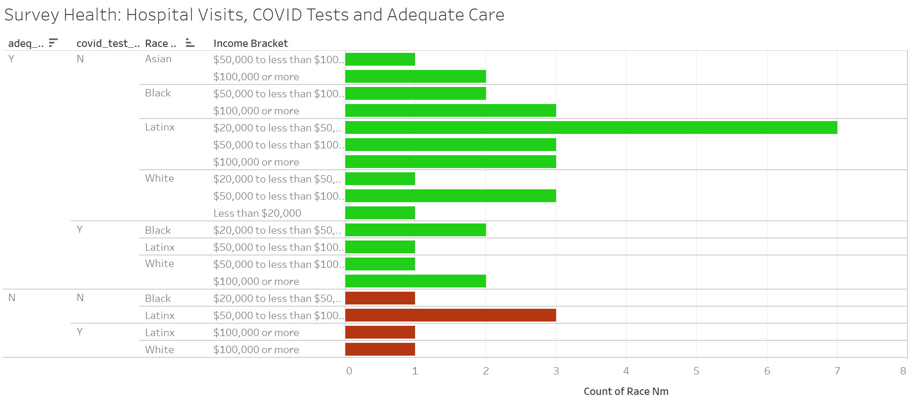
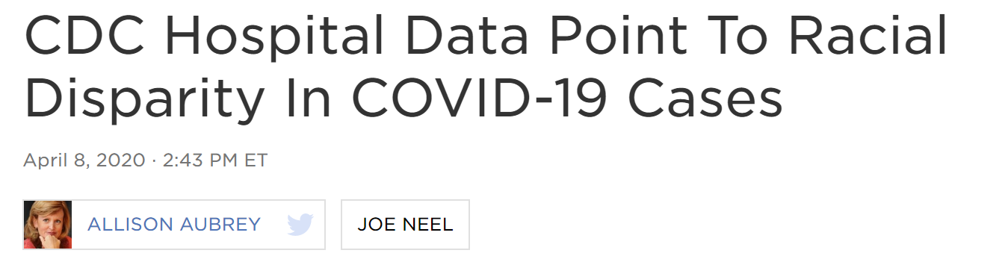
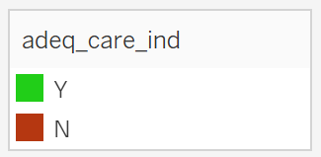
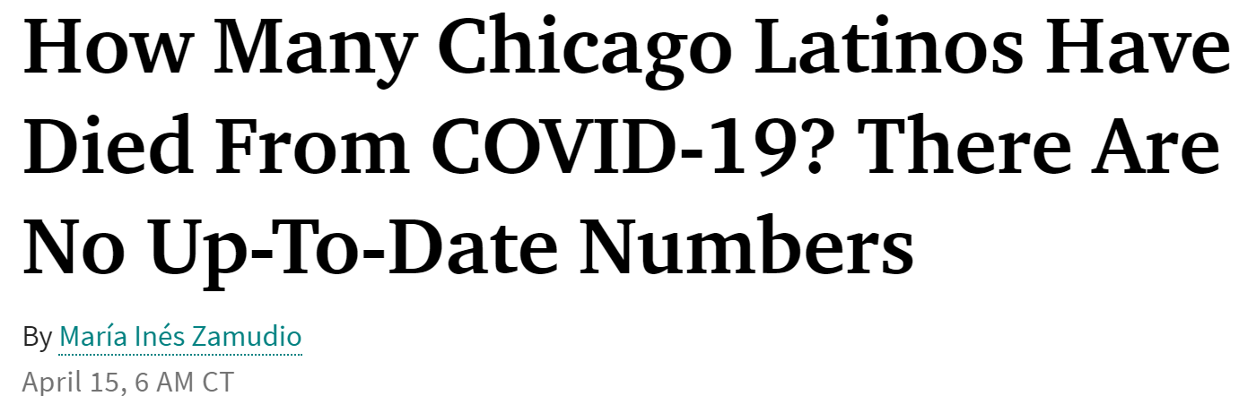
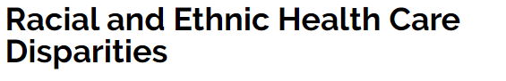
Population Distribution by Race
Respondents by Race | C-19 Test | Hospital Visits | Bad Hospital Experience
White N=50 | 12% | 18% | 11%
Latinx N=89 | 10% | 20% | 22%
Black N=55 | 4% | 15% | 13%
Asian N=24 | 8% | 13% | 0%
https://www.npr.org/sections/coronavirus-live-updates/2020/04/08/830030932/cdc-hospital-data-point-to-racial-disparity-in-covid-19-cases
https://www.wbez.org/stories/how-many-chicago-latinos-have-died-from-covid-19-there-are-no-up-to-date-numbers/8835a044-05bd-4503-985a-3bb11cf45df7
https://medicareadvocacy.org/medicare-info/health-care-disparities/

Slide 29
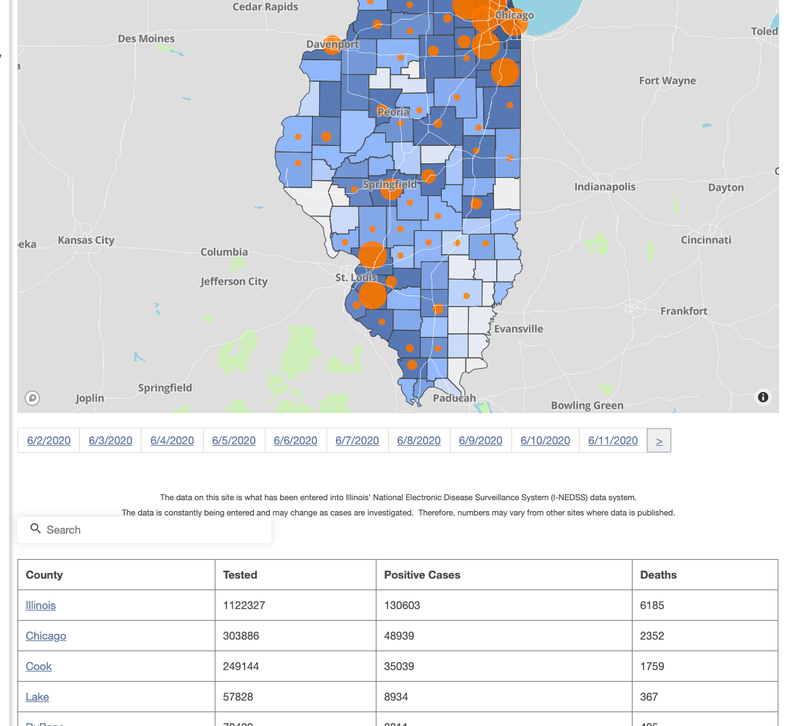
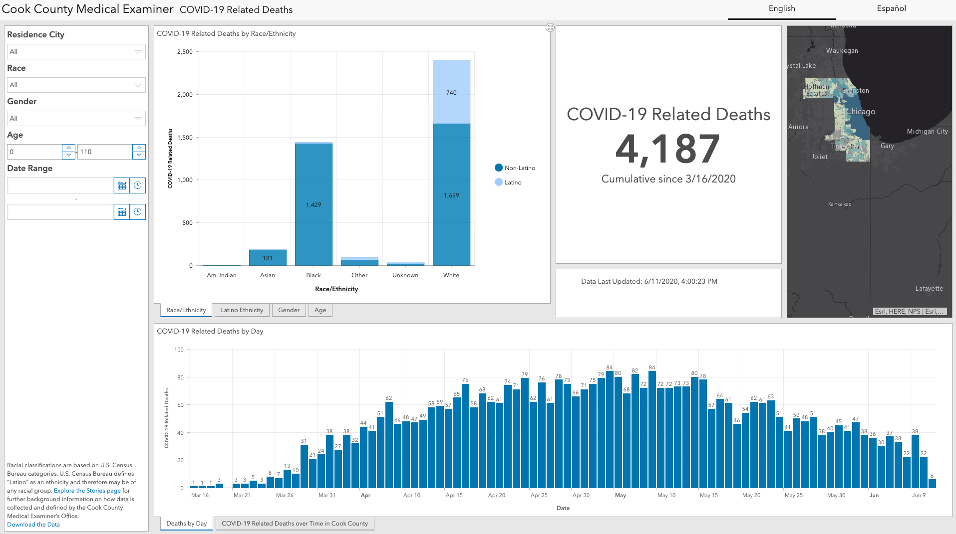
Nursing Home Insights
Illinois Department of Public Health
Cook County Medical Examiner
Notes:
Thanks Cristal.
This is a general snapshot of our initial COVID research. The IDPH information on the left was limited because it was hard to scrape and combine their demographical and death information. Also, they separated Chicago out of Cook County.
The Cook County medical examiner information on the right had better data, but it was incomplete and required a lot of cleaning.

Slide 30
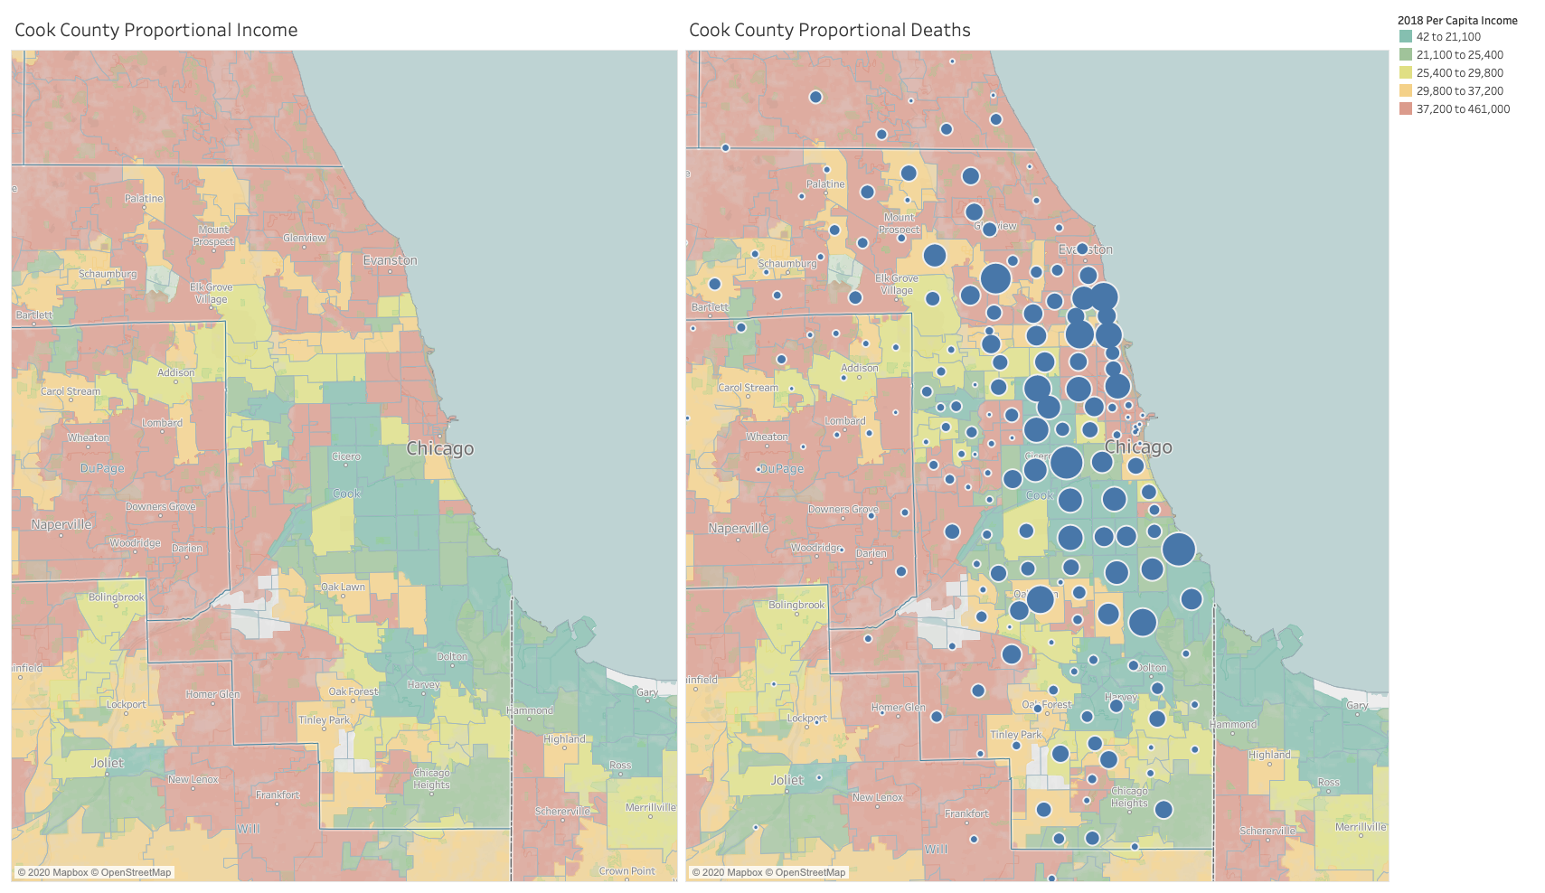
Notes:
Based on our initial business case, we wanted to look for patterns related to the socio-economic and/or race correlation on COVID cases in Cook County...based on zip codes. The map on the left shows the individual per capita incomes in COok county based on zip codes.
On the left you can see a definite concentration of cases in the neighborhoods of Chicago, moreso in Latinx and African-American neighborhoods, but nothing definitive based on ethnicity.

Slide 31
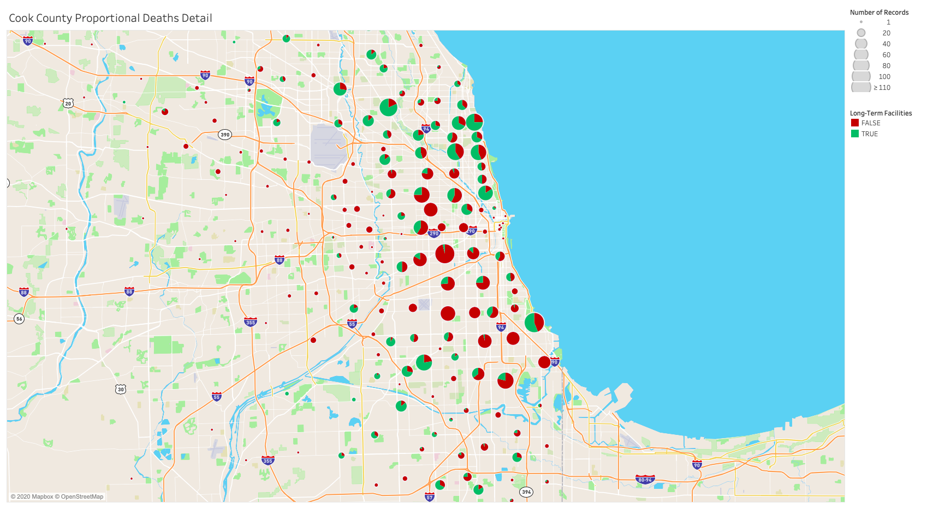
Notes:
Getting into more detail we can now see patterns related to facilities (not just nursing homes but independent living apts., Adult homes, assistive living homes, mental care facilities, retirement homes, etc.) CMS, my agency, was limited to reported only nursing homes which is incomplete. In addition, some nursing homes only reported deaths occurring in the facility and not after a long-hospital inpatient stay.
In fact, our group discussed this discovery nearly a week prior to an Chicago Sun Times artcile discussing the same information.
We noticed that the high number of cases in more affluent zip codes were concentrated in these type of facilities whereas in Latinx and Afrincan-American neighborhoods the spread was from local contact. Basd on the timeline African-American cases have stabalized whereas the current increase in happening within the LatinX community closer to blue-collar areas.

Slide 32
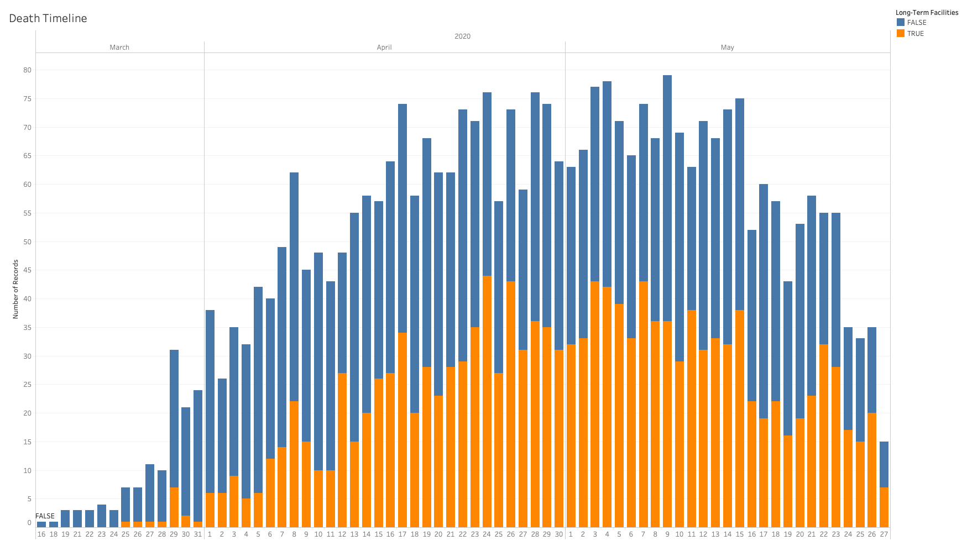
Notes:
This timeline further demonstrates the portion of cases from breakouts at facilities. The gold are from cases from LTCF and the blue are from cases outside LTCF.

Slide 33
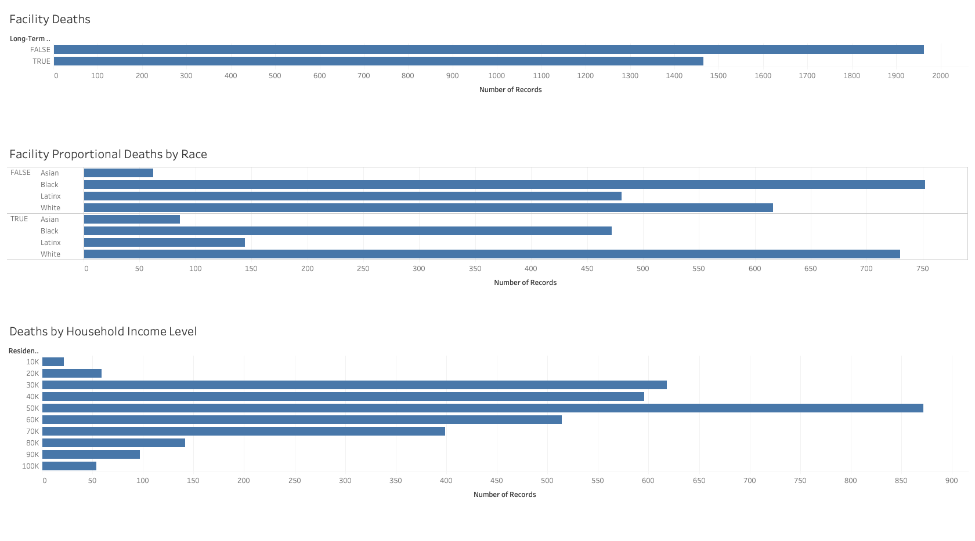
Notes:
Some highlights are:
We can see the disporportionate number of Latinx and African-American deths outside of facilities.
We can see the disporportionate number of cases in poorer housholds based on deaths at "median-income household" levels.
For families these incomes are very low.

Slide 34
Conclusion

Slide 35

Conclusion
News Polarity Analysis and Social Distancing:
News picked up Covid-19 reporting early on but did not seem to influence people's behavior
Social Distancing began heavily and continued uniformly after WHO declared a pandemic.
Survey:
Carefully consideration of ethnic-related data is essential to make sure we capture and address historical disparities related to health care early on; especially during time sensitive emergencies.
COVID - Data Collection:
In order to get comprehensive COVID data for analysis CDC should incorporate medical examiner data from all US counties and get comprehensive facility data detail. A dashboard could easily be created to report daily details for quick responses to the spread of COVID.
Notes:
Low news impact on behavior
WHO's pandemic declaration had an impact.
It's important to consider ethnic-related data in COVID surveys.
CDC should better incorporate medical examiner info., and
Create a compehensive dashboard.

Slide 36
Lessons Learned Recommendations
Survey:
Adjust questions
Distribute to wider audience within Cook county that reflects ethnic distribution of population.
NoSQL Database would suit recent and ever-evolving data better.
Uniform/standardized federal data collection guidelines should be implemented; specially to capture disproportionate effects on groups early on.
Federal government data not standardized.
Normalize and validate data against different data sources more.
Web scrape data daily to capture data timeline.
Research occupation specific to essential workers and difference between COVID-19 deaths and co-morbidity deaths.
Using Python try/except for big data sets makes it hard to distinguish researcher error from missing/anomalous data
Using Python try/except for big data sets makes it hard to distinguish researcher error from missing/anomalous data
Develop data checks to perform before running the cleaning code. Only run the cleaning code on data that is known to be valid.
Notes:
Some highlights are to lesson learned/recommendations are:
Normalize and validate data against different data sources more.
Use NOSQL
Standardize federal health data collection.
Web Scrape on a daily basis.
Advocate for the importance of federal data collection guidelines for quicker analysis and succinct data that will capture disproportionate effects earlier.

Slide 37
References
Census data provided by ZipCityMaps : https://www.zip-codes.com/county/il-cook.asp
IDPH data provided by WBEZ: https://www.wbez.org/stories/map-find-the-number-of-covid-19-cases-in-illinois-by-zip-code/90ca85cd-bdf4-423a-a7bc-924fcee9d0f3
Measuring New Sentiment (Federal Reserve Bank of SF): https://www.frbsf.org/economic-research/files/wp2017-01.pdf
SafeGraphSocialDistancingMetrics: https://docs.safegraph.com/docs/social-distancing-metrics
DataWorld (County-Zipcode): https://data.world/niccolley/us-zipcode-to-county-state
Survey Questions: see slide 26.

Slide 38
THANK YOU
Stay Safe
Questions?

